Slide 1


Slide 2

FINANCIAL FRAUD DETECTION USING BATCH PROCESSING
Sama Ayman Zaky, Belal Mohammed, Abdelrahman Yasser, Khaled Atef, Salma Deiaa

Slide 3

OVERVIEW
01
Objective
02
Data Ingestion
03
Data Processing
04
Machine Learning
05
Data Storage & Querying
06
Visualization
07
Expected Outcomes

Slide 4


AIM
This project aims to build a robust system for detecting financial fraud using batch processing techniques. We’ll cover the core objectives, how data is ingested and processed, the application of machine learning models, and the visualization of results. The goal is to identify fraudulent activities within large datasets accurately. Let’s dive into each section.

Slide 5
01
Ingest Financial Data:
Import large volumes of data into Hadoop HDFS using Sqoop.
PROJECT OBJECTIVES
02
Process and Transform Data:
Use Apache Spark for processing.
03
Query Results:
Store and query processed data in Apache Hive.
04
Apply Machine Learning:
Detect fraud using algorithms like Decision Trees and SVM.
05
Visualize Results:
Generate reports using Business Intelligence (BI) tools.

Slide 6


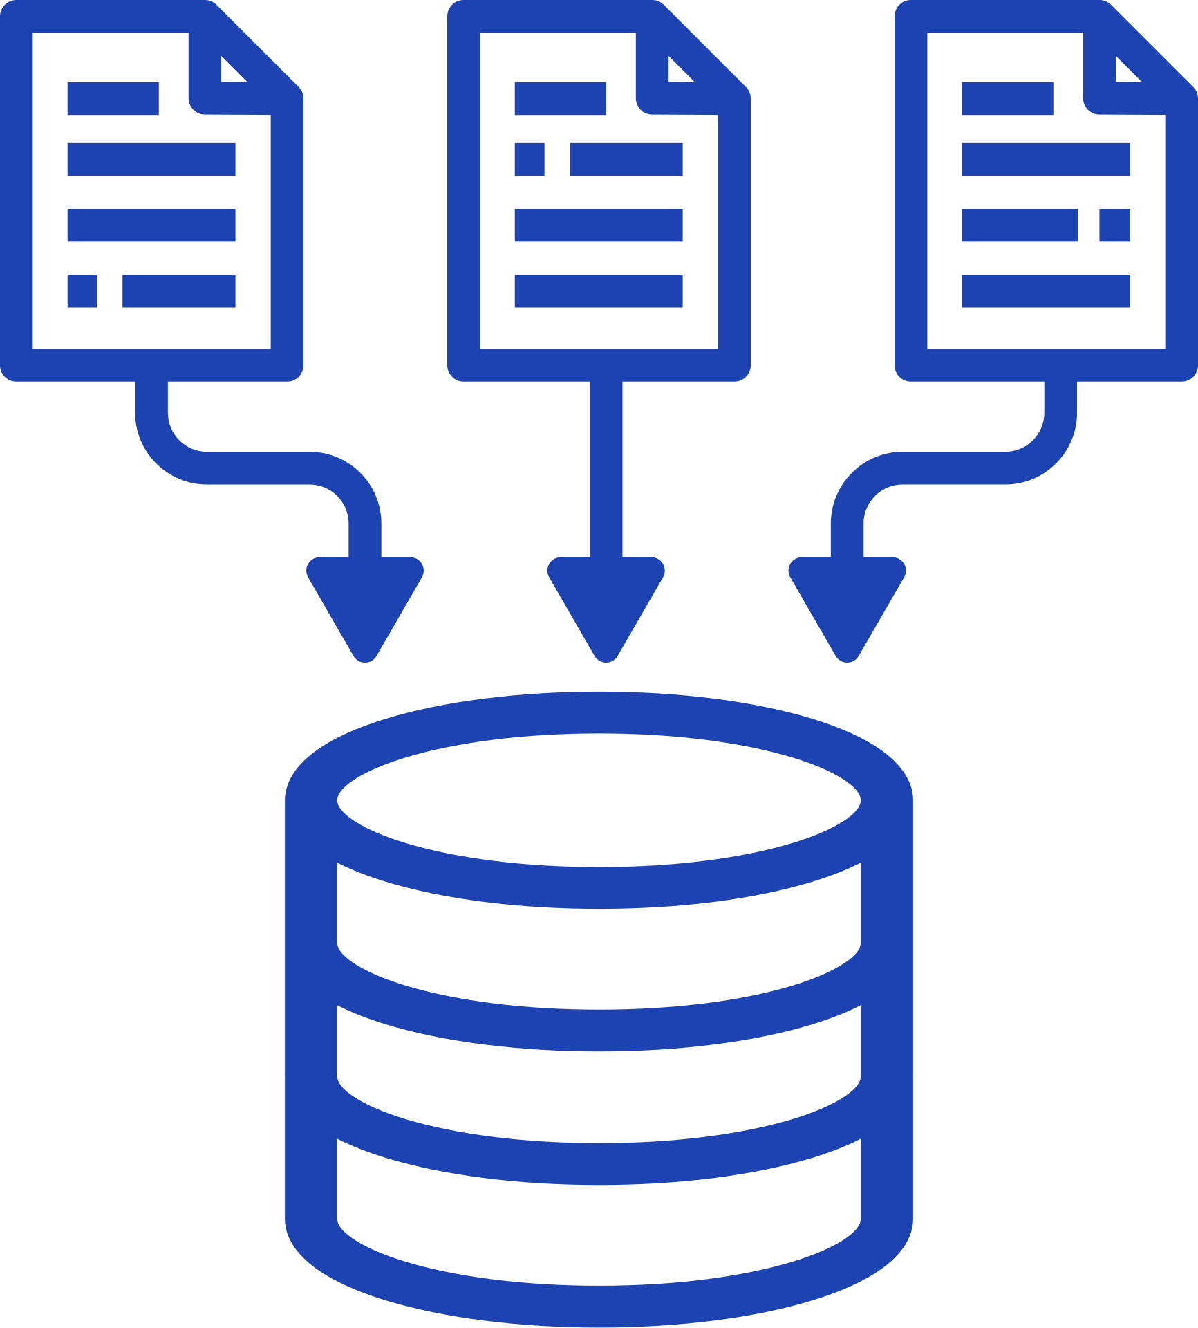

DATA INGESTION (MARIADB & HADOOP)
MariaDB Setup:
Start MariaDB and create the financial_fraud database.
Create table schema for transaction data.
Data Import:
Load data from CSV into MariaDB, then ingest into Hadoop HDFS using Sqoop.

Slide 7






PREPROCESSING
Drop Unnecessary Columns:
Removed columns like nameOrig, nameDest, and isFlaggedFraud.
Handle Missing Values:
Filled missing values with column means.
Address Data Imbalance:
Used under-sampling to balance fraudulent vs. non-fraudulent transactions.
One-Hot Encoding:
Transformed categorical data (e.g., transaction types) into numerical form.

Slide 8



MACHINE LEARNING MODELS
Gradient Boosted Tree:
Random Forest:
Logistic Regression:
100 trees
97% accuracy.
10 iterations
94% accuracy.
50 iterations
99% accuracy (best performance)

Slide 9

DATA STORAGE & QUERYING
Number of fraudulent transactions
Total transaction count
Total transaction amount by type
Top 10 destinations by transaction value
Average transaction amount by step

Slide 10
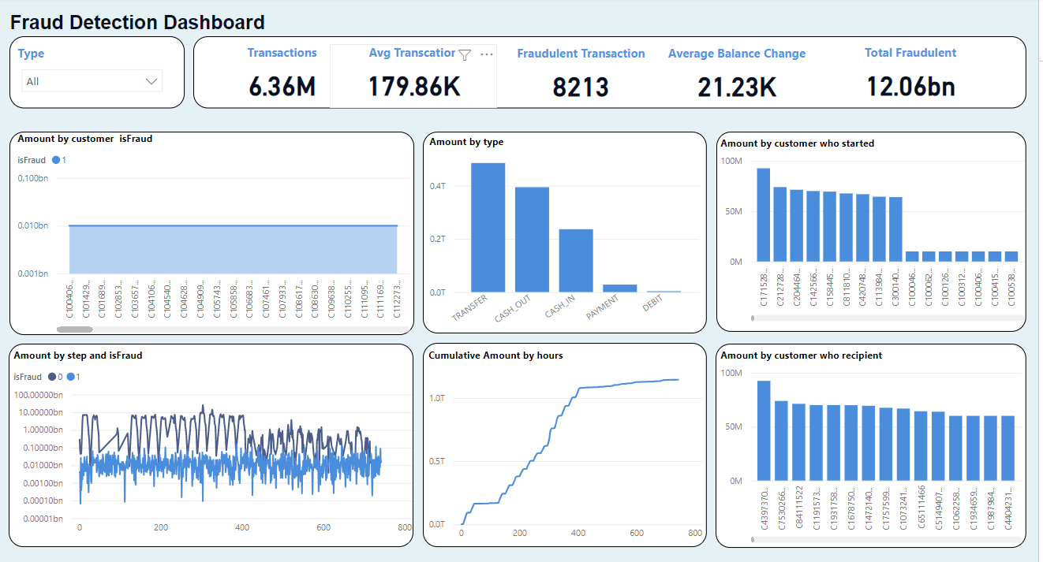
FRAUD DETECTION DASHBOARD OVERVIEW
Key Insights:
Transaction Types: Highest fraud rates in TRANSFER and CASH-OUT.
Customer Analysis: Specific customers account for most fraudulent activities.
Temporal Trends: Peaks in transaction volume indicate higher fraud likelihood during certain hours.

Slide 11

01
Real-time Processing:
Implement real-time fraud detection using tools like Apache Kafka and Spark Streaming.
FUTURE WORK
02
Algorithm Expansion:
Experiment with XGBoost and Neural Networks to improve detection accuracy.
03
Advanced Feature Engineering:
Explore additional features like transaction time and geographic location for more detailed fraud insights.
04
System Deployment:
Deploy the system in a live environment and monitor for continuous improvement in detecting fraudulent activities.

Slide 12

THANK YOU
FOR YOUR ATTENTION

